Slide 1
Software Design Document Project Name: Warehouse Management System
Version 1.0 approved
Prepared by
<Tendongfor Nick, Ashu Boris Ayuk, Njicha Prince, Akwayi Austine>
<CHITECHMA UNIVERSITY>
<24th January 2023>
Supervisor: Mr Ngala Dirane

Slide 2
Table of Content
Introduction
System Overview
Design Considerations
Assumptions and Dependencies
General constraints
Proposed Solutions
Goals and Milestones
System Architecture
Detailed System Design
Existing Problems
Proposed Solutions
Timeline

Slide 3
Introduction
A warehouse management system is a software application that helps control and manage the day-to-day operations in a warehouse.
The warehouse management system is designed to offer visibility in a business’ entire inventory and manages supply chain fulfillment operations from the distribution center to the store. This system also helps to customize tracking of goods, increase the companies productivity.

Slide 4
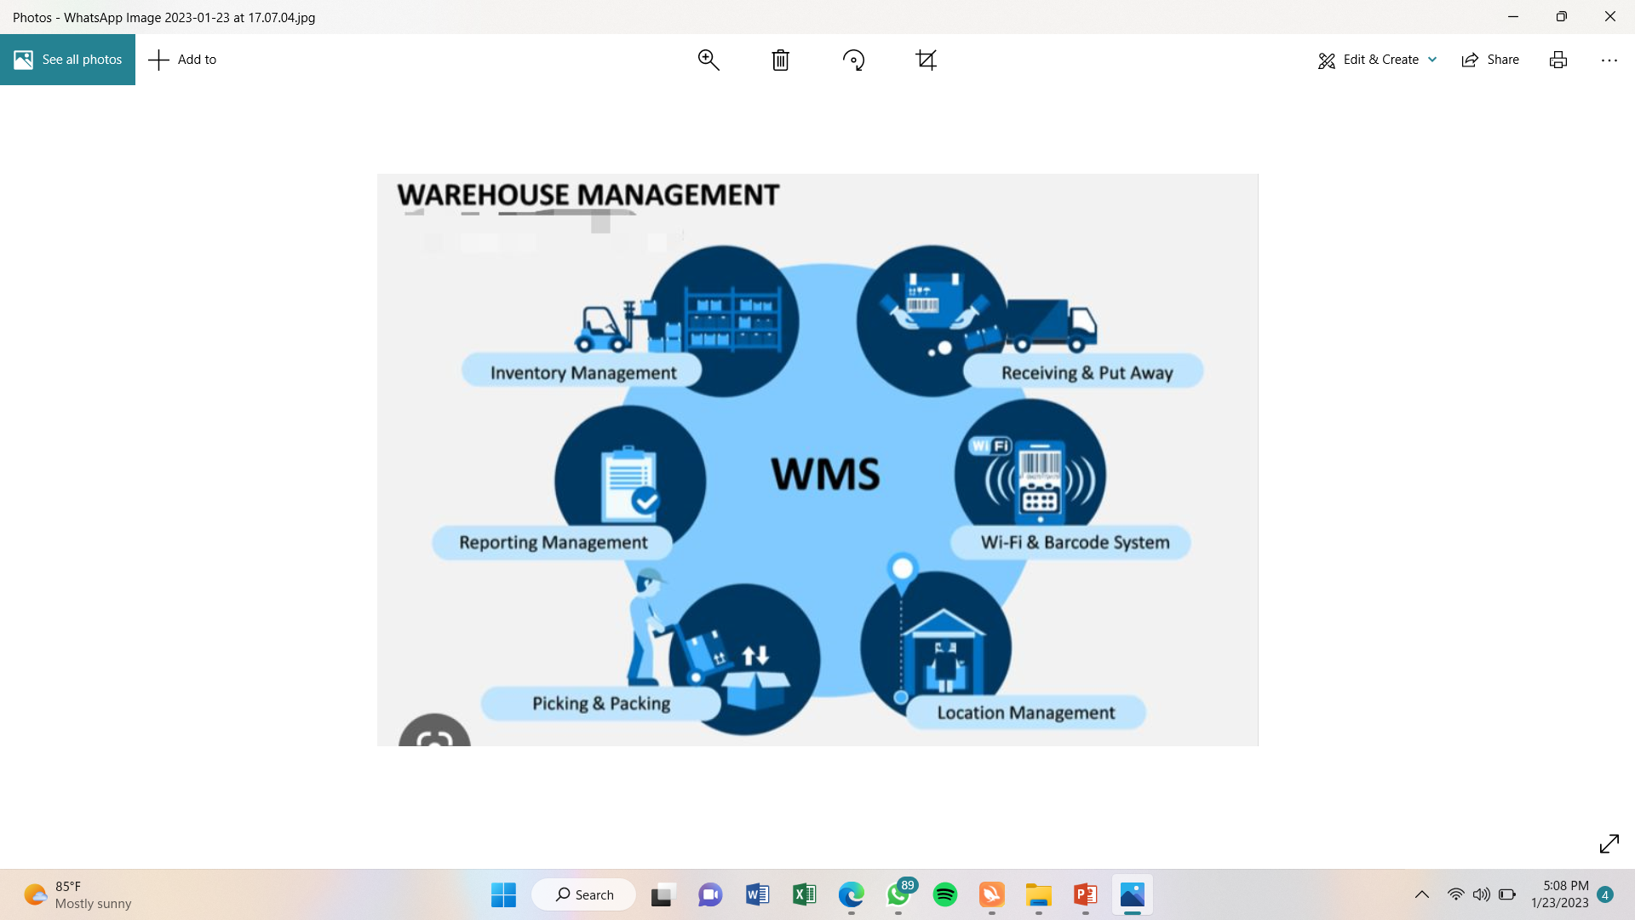
System Overview

Slide 5
System Overview
This software is designed to ease goods are stored, sold, check stock and how inventory is done. When goods arrive the shipping port, all identical goods are put an identical barcode understandable only by the company. When these goods arrive the company, the barcode reader is used to identify all identical goods. These goods will be entered into the system, upon arrival with the help of the barcode, which scans through all goods when they arrive. When the goods have been kept in the magazine, a minimum and maximum price is setup for all goods which can only be modified by the IT manager. Upon selling, the barcode is still used to search for the goods name. When this is done, the price of the good also appears and the quantity (no of cartons) is recorded manually or the barcode is passed through the carton multiple times until the desired number is attained.

Slide 6
Design Considerations
Assumptions and Dependencies:
-The users of this system have basic computing knowledge.
-This system works more efficiently with cartonized goods
General Constraints
- Damaged Products: When an item gets damaged, it generates a cost for warehouse operations. To avoid this, we recommend cartonizing all goods.
- Being Unprepared for the demand: Having timely information may help forecast the demand correctly and thus avoid an excess inventory that raises storage costs or a lack of stock that results in lost sales.
Proposed Solutions
- Identical goods are packaged in cartons. This will also help reduce space goods occupy.
- Advanced inventory management softwares are created which helps create accurate and transparent outfitting.
-
Goals and Milestones
-Ensuring that goods and materials move through warehouses in the most efficient and cost effective-way.
-Maximise the use of storage space
-Understanding stock levels and stock locations in a warehouse
-Improve Customer Satisfaction
-Improve accuracy and visibility
-Improve employee productivity
-

Slide 7
System Architechture
System architecture is the central repository for all the data. It shows the various ways in which the warehouse function .Warehouse architecture defines the overall architecture of data communication processing and presentation that exist for end clients. System architecture automates the warehouse management system in smart warehouse for industries and it covers everything you have to know about designing a data warehouse .

Slide 8
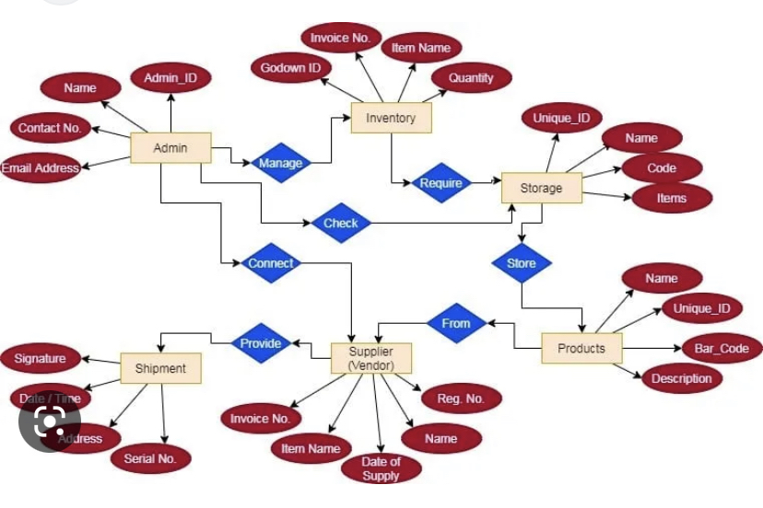
System Architecture

Slide 9
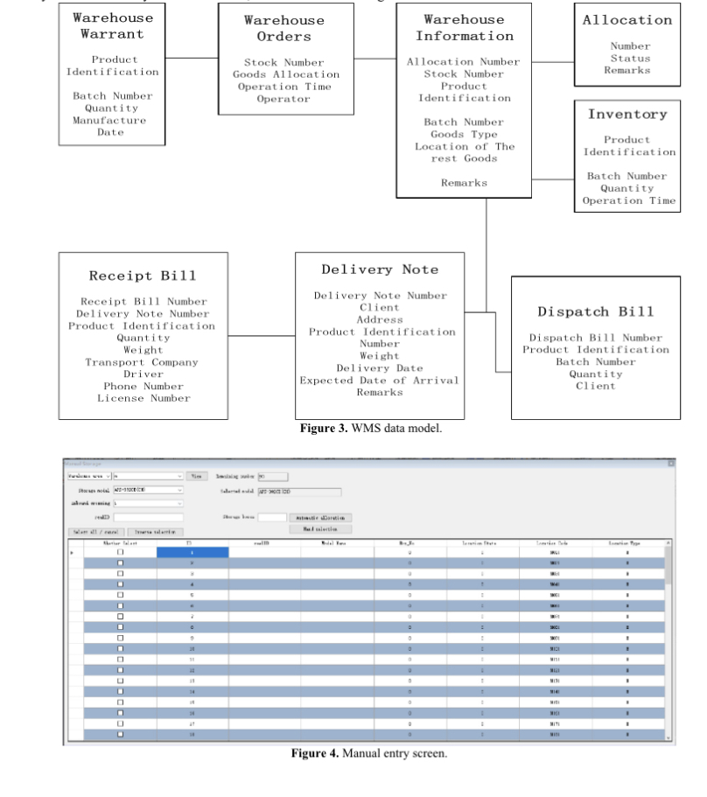
Database Design

Slide 10
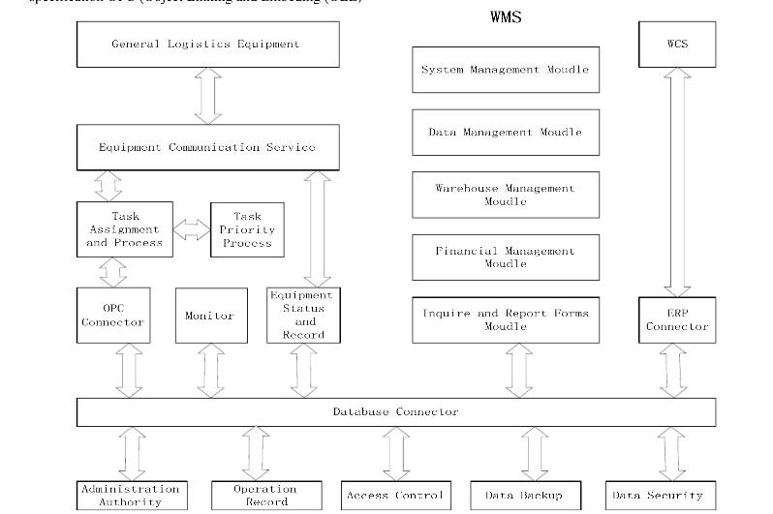
Detailed System Design

Slide 11
Existing Problems
High labor cost and inaccurate information.
Damaged goods generates unnecessary cost

